Slide 1
Variational Graph AutoEncoders

Slide 2
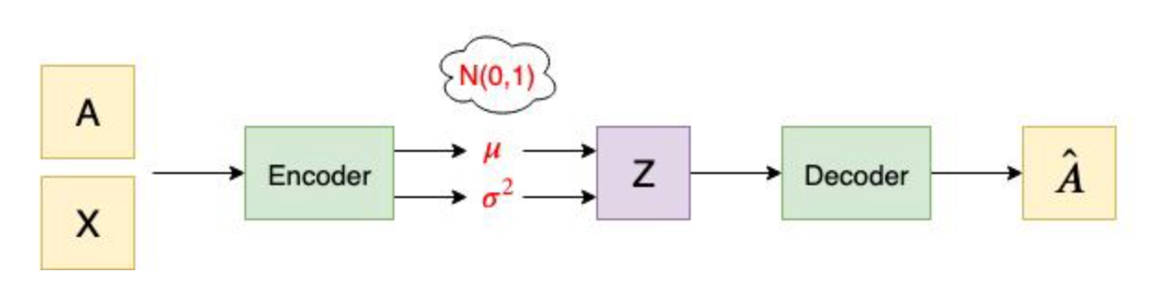
The architecture of the Encoder and Decoder
Encoder: two layer GCN

Slide 3
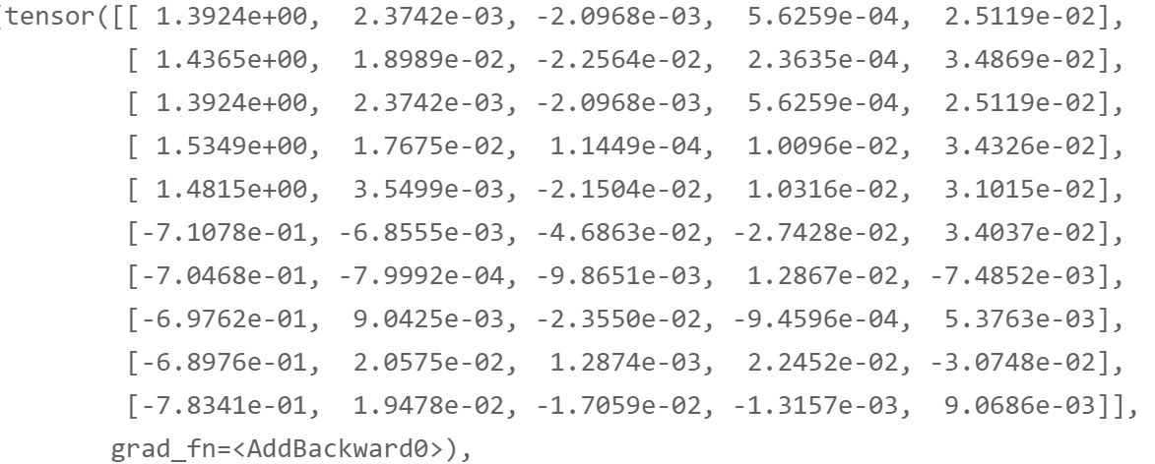
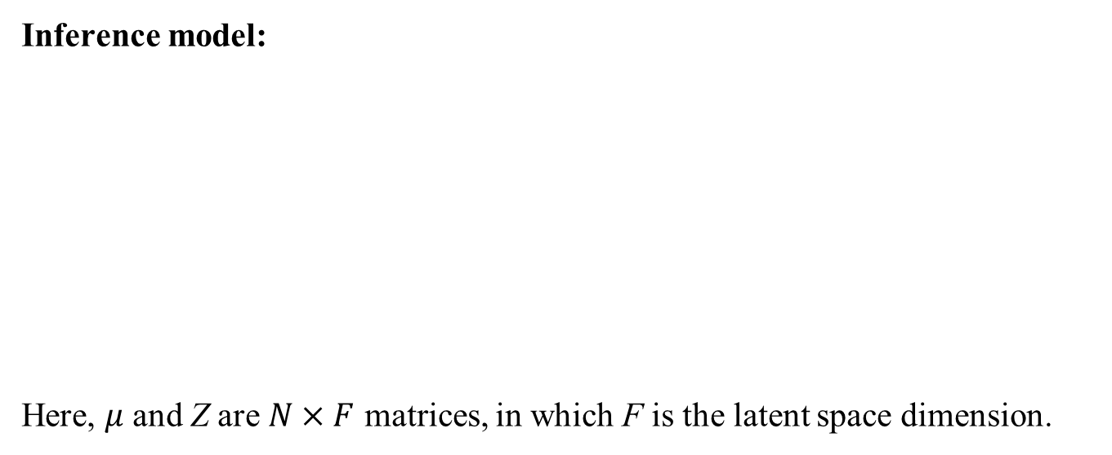
The architecture of the Encoder and Decoder
Inference model:
Here, $μ$ and Z are $N×F$ matrices, in which F is the latent space dimension.

Slide 4
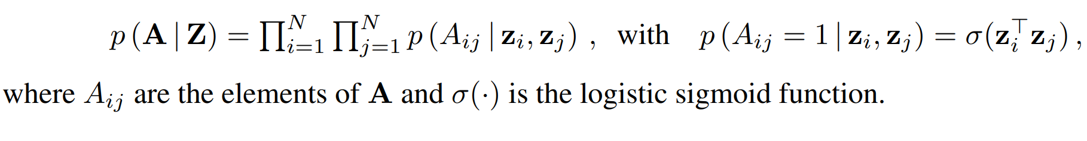
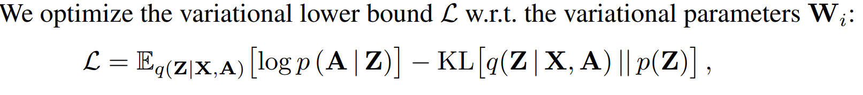
The architecture of the Encoder and Decoder
Generative model:
in which

Slide 5
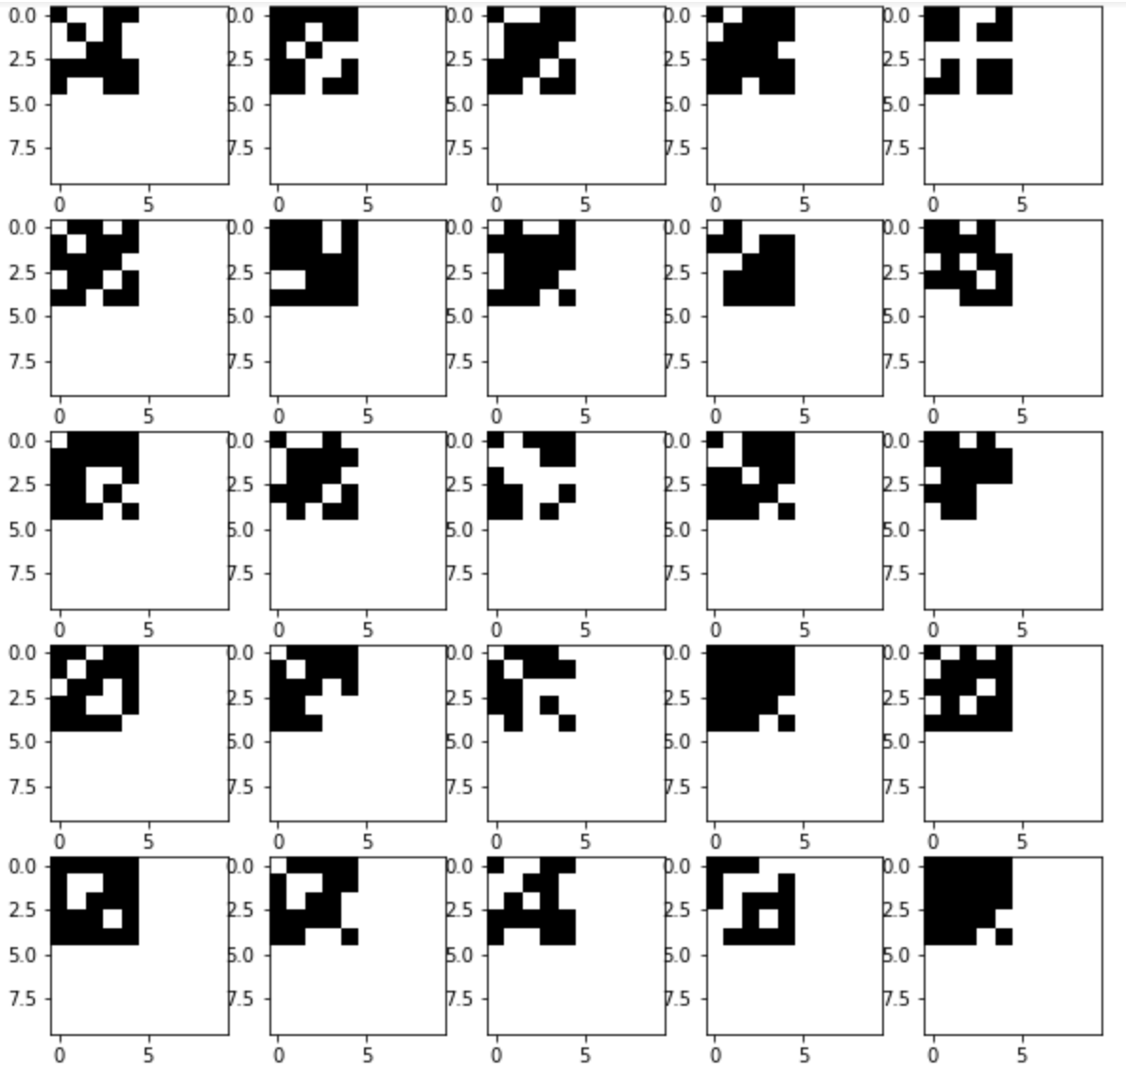
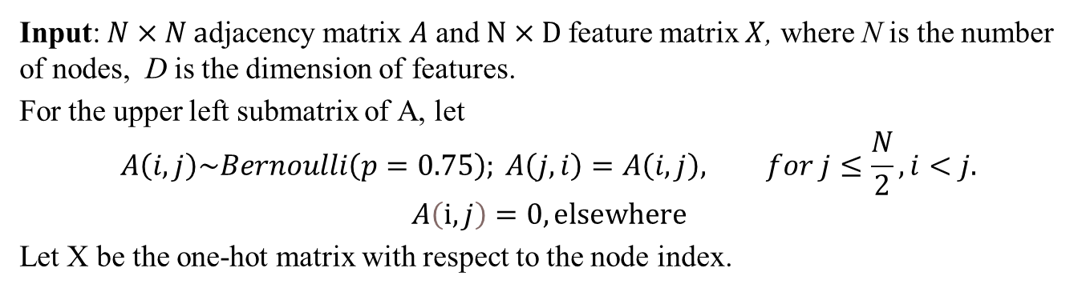
Input for simulation
Input: $N×N \text{a}\text{djacency} \text{matrix} A$ and $N×\text{D}$feature matrix $X$, where N is the number of nodes, D is the dimension of features.
For the upper left submatrix of A, let
$$A\left(i,j\right)\sim Bernoulli\left(p=0.75\right); A\left(j,i\right)=A\left(i,j\right), for j≤\frac{N}{2}, i<j.$$
$$A\left(ⅈ,j\right)=0, elsewhere$$
Let X be the one-hot matrix with respect to the node index.

Slide 6
Hyperparameters
Optimizer: Adams optimizer with learning rate = 0.01
Epoches = 100000

Slide 7
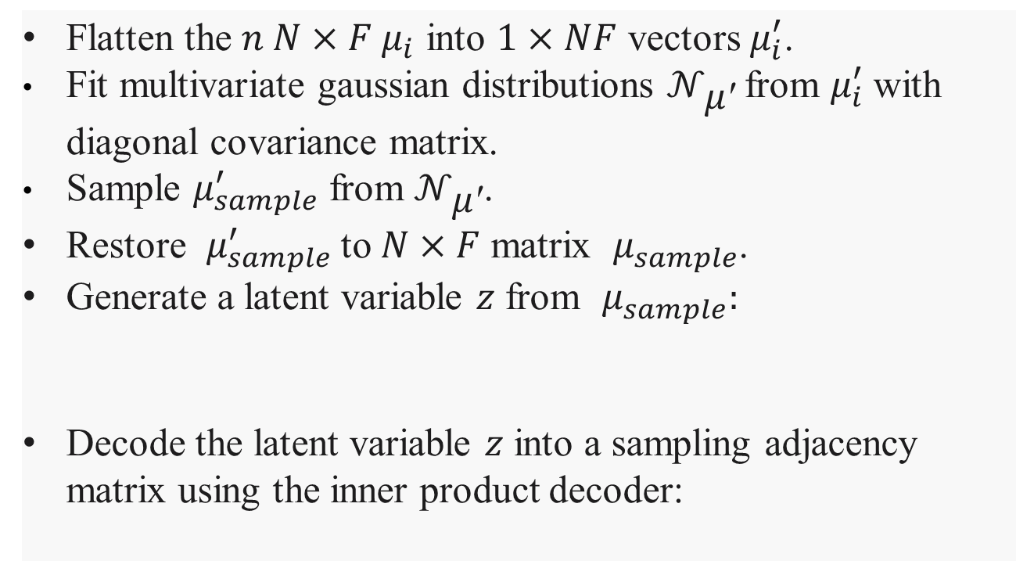
Sampling
Flatten the $n N×F μ_{i}$ into $1×NF$ vectors $μ_{i}^{′}$.
Fit multivariate gaussian distributions $𝒩_{\text{μ}\text{′}}$from $μ_{i}^{′}$with diagonal covariance matrix.
Sample $μ_{sample}^{′}$ from $𝒩_{\text{μ}\text{′}}$.
Restore $μ_{sample}^{′}$to $N×F$ matrix $μ_{sample}^{ }$.
Generate a latent variable $z$ from $μ_{sample}^{ }:$
Decode the latent variable $z$ into a sampling adjacency matrix using the inner product decoder:
$$q\left(z\right)=𝒩(z|μ_{sample}^{ },mean(diag\left(σ\right))$$

Slide 8
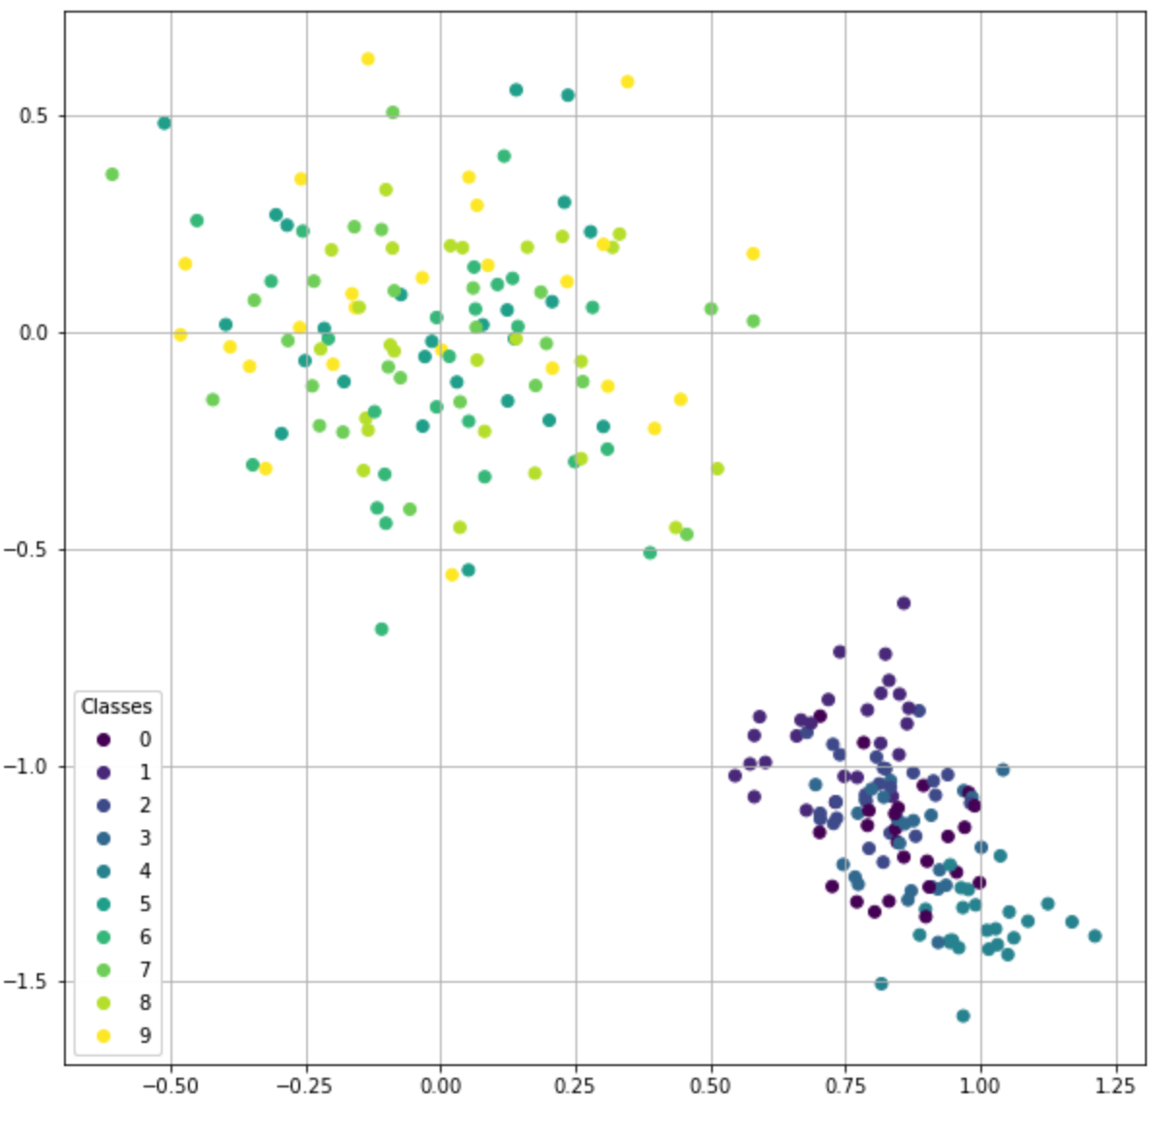
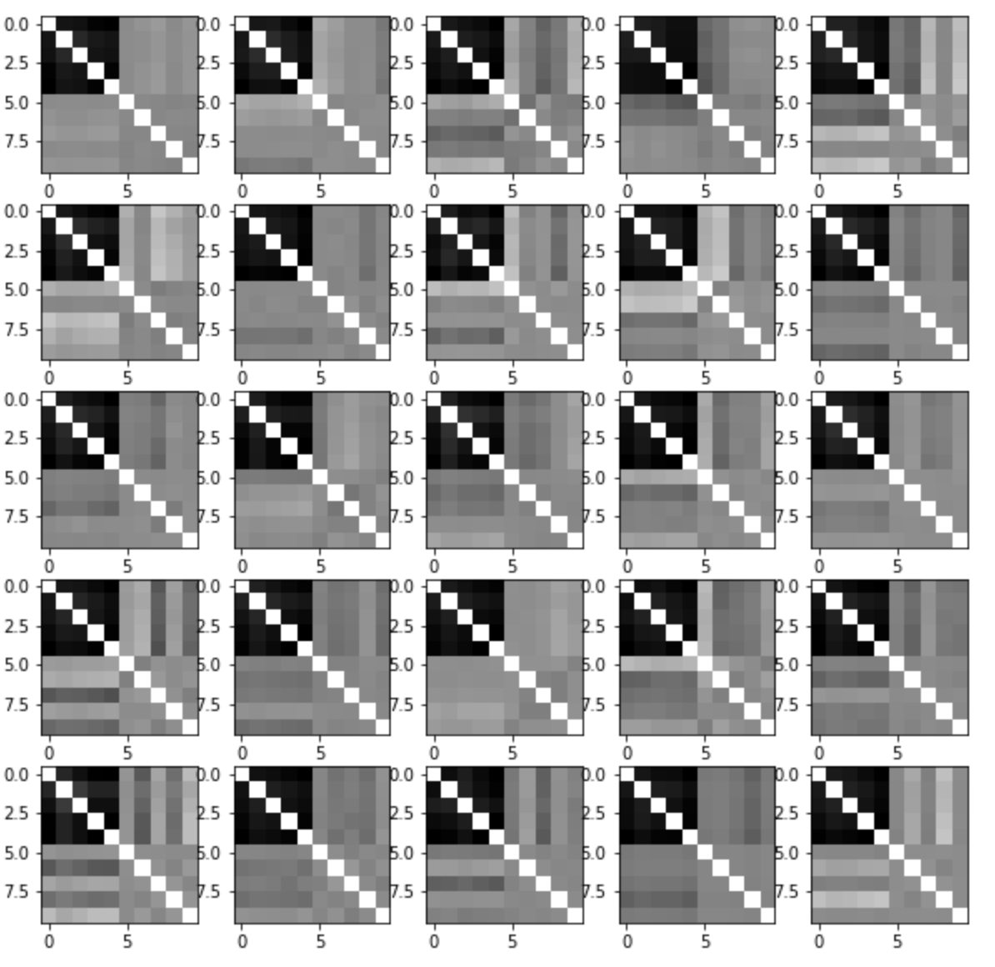
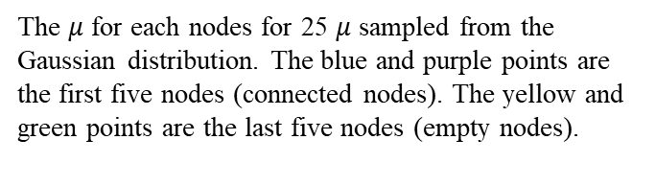
Sampling
The $μ$ for each nodes for 25 $μ$ sampled from the Gaussian distribution. The blue and purple points are the first five nodes (connected nodes). The yellow and green points are the last five nodes (empty nodes).
25 generated adjacency matrices.

Slide 9
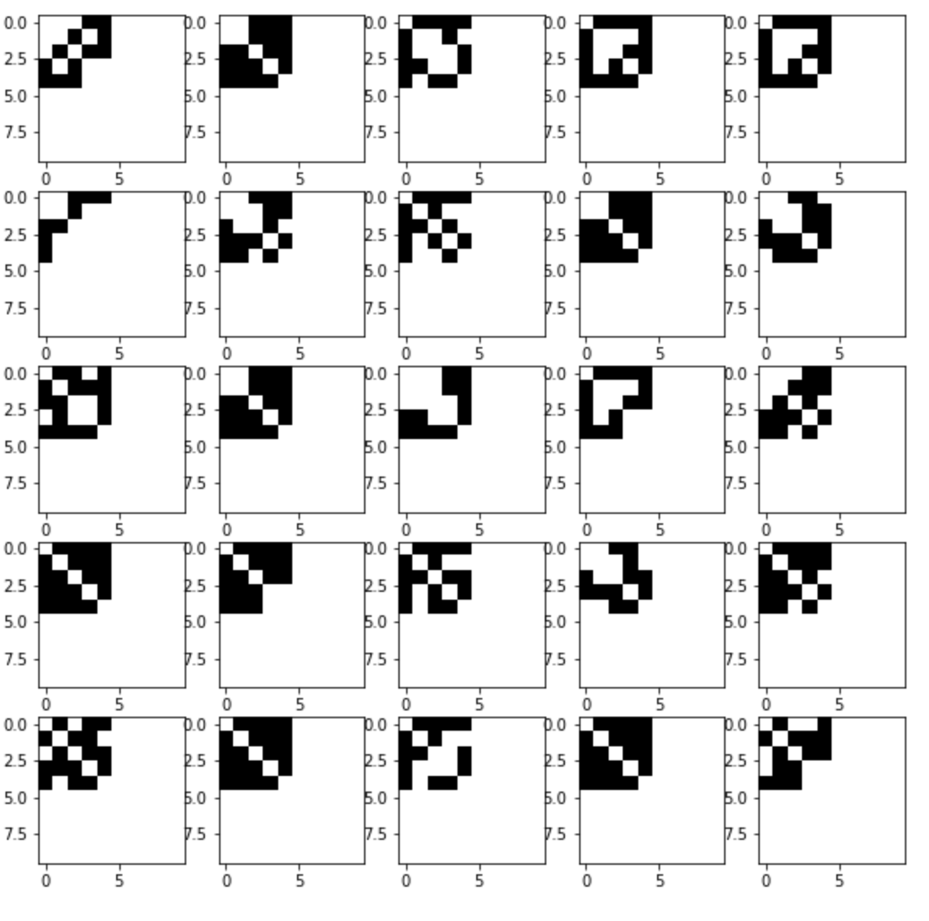
Comparision
original
generated

Slide 10
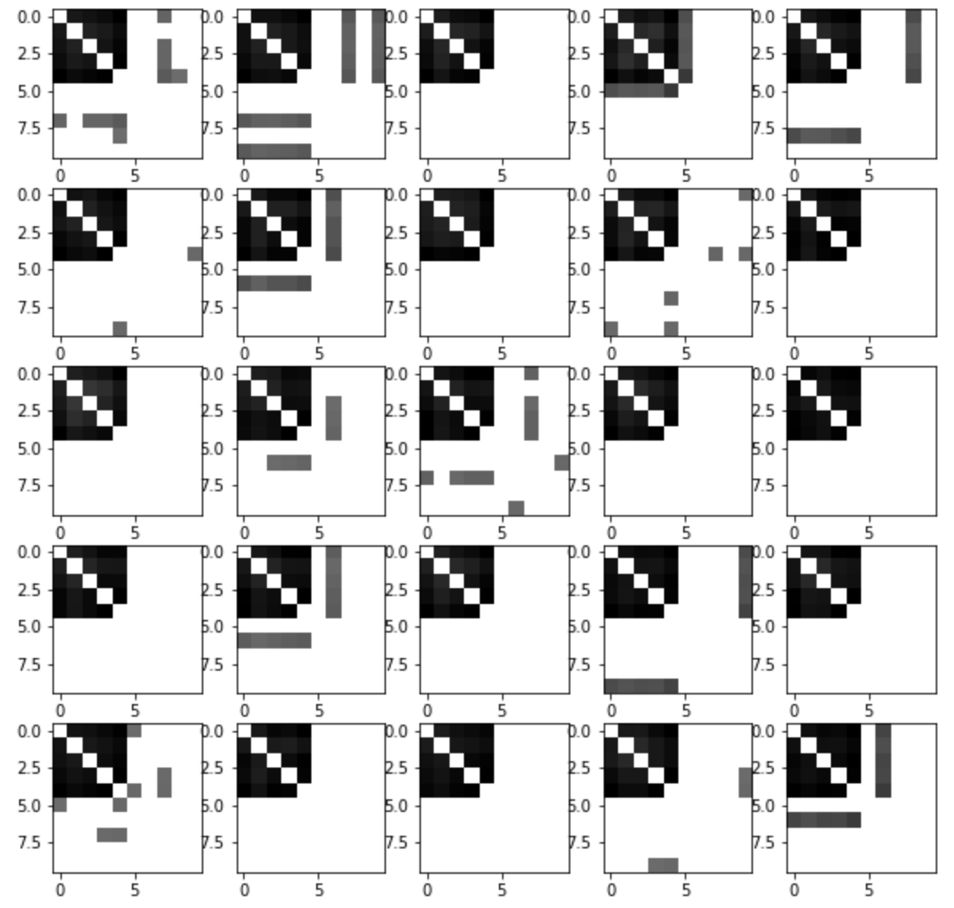
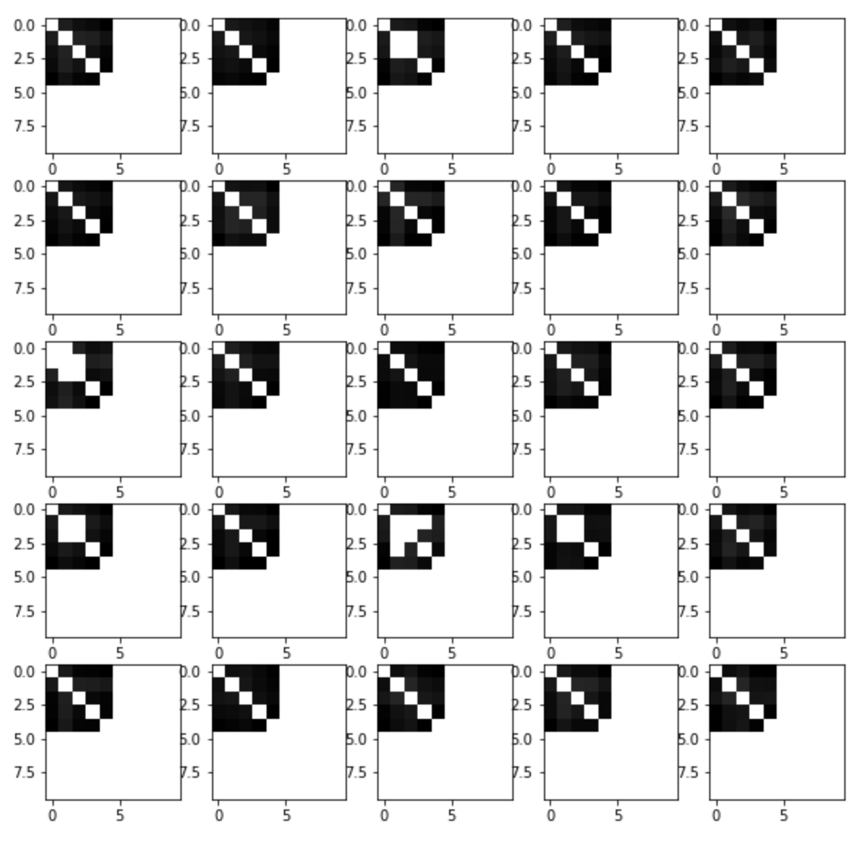
Comparision
original
Generated with filter value=0.3
Generated with filter value=0.5

